Slide 1
2021 MLP Item Robotic Mobile Fulfillment System
Yonsei University
Machine Learning Project Team 09
2021.04.14

Slide 2
Outline
Item 폴더: instance 구성 위주
Item Storage pod에 item 넣을 수 있는 방법(RPS)
Resource폴더: Item Distribution, Name, number.. 지정

Slide 3
Simulation
Instances
Bot
ItemTransferTime
ItemPickTime
ItemBundleTransferTime
ItemType : SimpleItem, Letter
OrderMode: Fill, Possion, Fixed
Orders
ItemDescriptionCount
DefaultWeight
DefaultCoWeight
ProbWeightDistributionType: Uniform, Gamma, Normal, Exponential, Constant

Slide 4
Configurations -> ItemConfiguration.cs
ColoredWordConfiguration
A configuration to use when colored letters are used as items.
SimpleItemConfiguration
A configuration to use when ID-based items are used that can have meaningless coloring (to distinguish them).
SimpleItemGeneratorConfiguration
A configuration that is used when simple items are generated randomly.

Slide 5
Folder: Items
ColoredLetterBundles.cs / ColoeredLetterDescription.cs
“LetterBundles” + ID
ItemDescription.cs
SKU = ItemDescription
Bundlesize = -1
Weight = 한 item의 무게
Itemtype.cs / LetterColors.cs
SimpleItem, Letter
Red, Green, Blue, Yellow
추가 가능
SimpleItemDescription.cs
SKU = ID로 구현
“SimpleItemDescription” + ID

Slide 6
Folder: ItemStorage
Pod에 Item 넣는 code(RPS)
Implements a storage manager using the closest free pod.
ClosestLocationStorageManager
Creates a correlative storage manager that aims to assign bundles in a family based manner.
CorrelativeStorageManager
A manager that can be used when the decisions ordinarily made by a storage manager are conducted in another manager.
DummyStorageManager
Implements an item storage manager always choosing the emptiest pod for a bundle.
EmptiestStorageManager
Implements an item storage manager choosing the least demanded pod.
LeastDemandStorageManager
Implements a random storage manager that just randomly assigns bundles to pods.
RandomStorageManager
Implements a storage manager using the closest free pod.
ReactiveStorageManager

Slide 7
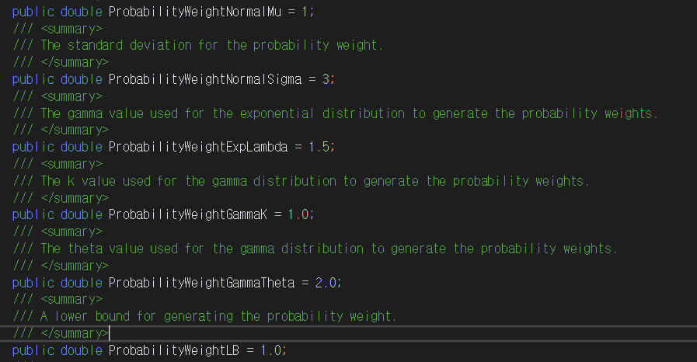
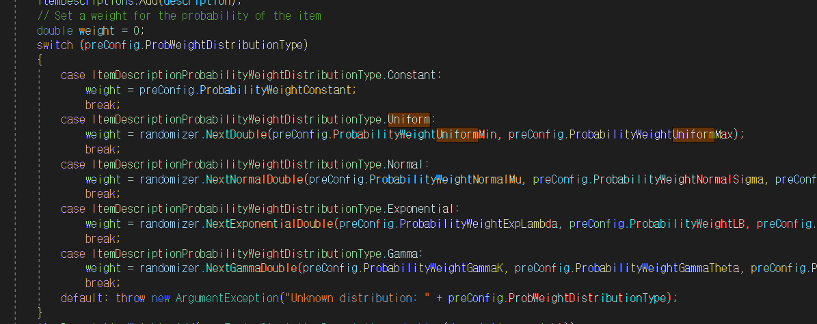
Generator -> OrderGenerator.cs
ItemDescription Probability Weight Distribution Type 지정 가능함
Probability parameter 변경 가능

Slide 8
Generator -> OrderGenerator.cs
확률을 online으로 생성
Constant Value
ProbabilityWeightLB = weight 확률의 lower bound
ProbabilityWeightUB = weight 확률의 upper bound
ItemWeightMu = item weight의 평균
ItemWeightSigma = item weight의 표준편차
ItemWeightLB = item weight의 최솟값
ItemWeightUB = item weight의 최댓값

Slide 9
Material -> Resource
Data about Order, Item, Item probability etc.
Item 이름은 Wordlist에서 변경 가능
Item Distribution txt로 추가 가능
Item 개수 지정 가능
Delta-1000 | ItemGen-3000-3000-0.00-0 | MaTi-10 | Mu-100 | Mu-500 | Mu-1000 | Repo-1000
bundelsize | Same
groups | #frequency value group count
Probability | 각각의 SKU에 따른 확률값을 넣을 수 있음
Simple | 각 SKU의 frequency
Weight | 각 SKU의 weight

Slide 10
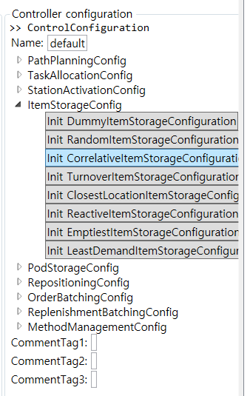

Slide 11
/// <summary> /// A class exposing methods to generate orders before starting the simulation and for generating configurations for online generation. /// </summary> public class OrderGenerator

Slide 12
public static OrderList GenerateOrders(
/// <summary>
/// Defines the type of distribution used when generating the probability weights for the item descritptions.
/// </summary>
public enum ItemDescriptionProbability Weight DistributionType
/// <summary>
/// Defines the type of distribution used when generating the weights for the item descriptions.
/// </summary>
public enum ItemDescriptionWeight DistributionType
/// <summary>
/// Defines the type of distribution used when generating the bundle size for the item descriptions.
/// </summary>
public enum ItemDescription BundleSize DistributionType

Slide 13
/// <summary>
/// A class supplying basic parameters for online generation of simple items.
/// </summary>
public class SimpleItemGeneratorPreConfiguration
/// <summary>
/// Generates a complete configuration for the simple item generator.
/// </summary>
/// <param name="preConfig">The pre-configuration defining characteristics of the actual configuration.</param>
/// <returns>The complete configuration.</returns>
public static SimpleItemGeneratorConfiguration GenerateSimpleItemConfiguration(SimpleItemGeneratorPreConfiguration preConfig)

Slide 14
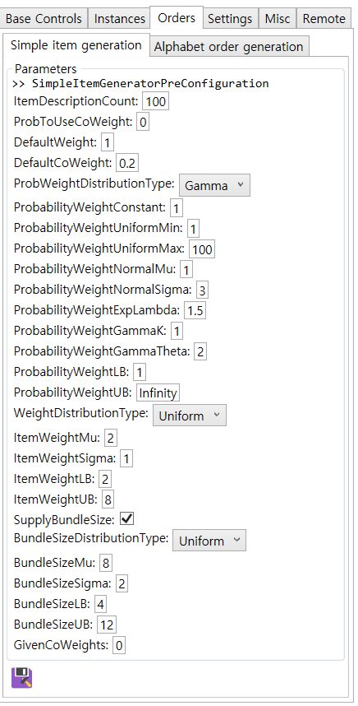
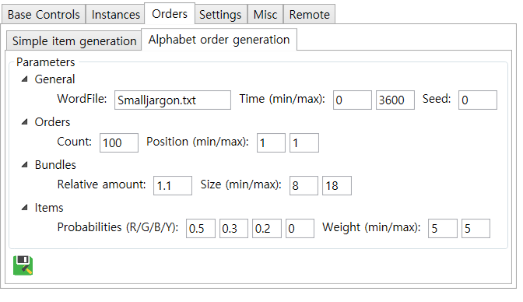
Item random -> order random
SimpleItemGeneratorPreConfiguration

